Slide 1
Mesopotamia:
Land Between the Rivers
Unit 7 Mesopotamia

Slide 2
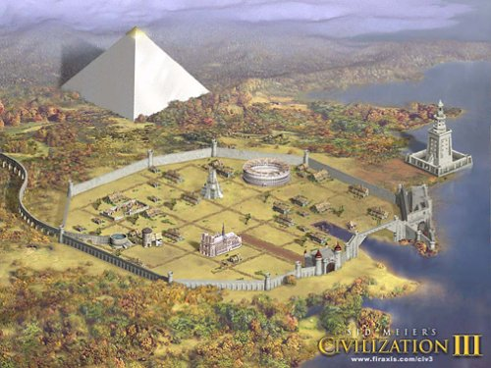
WHAT IS A CIVILIZATION?
How is the location of a civilization determined?
A civilization is a group of people living and working together for the purpose of creating an organized society.
A civilization has 8 features that make it a strong AND successful civilization.
CITIES WITHIN THE CIVILIZATION
GOVERNMENT & LAWS
WRITING
DIVISION OF LABOR
SOCIAL CLASSES
PUBLIC BUILDINGS/STRUCTURES
RELIGION
ART
The location of all civilizations is determined by the resources of the land

Slide 3
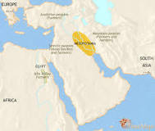
FINDING THE PERFECT LOCATION
Early humans were traveling the world to find the best location to settle permanently
They found a place in a region called the Fertile Crescent.
Mesopotamia is known as the land between two rivers.
It was the perfect location because it offered rich fertile land that was perfect for farming
Think: How does farming create permanent settlement?
WhY WAS mESOPOTAMIA THE PERFECT LOCATION?

Slide 4
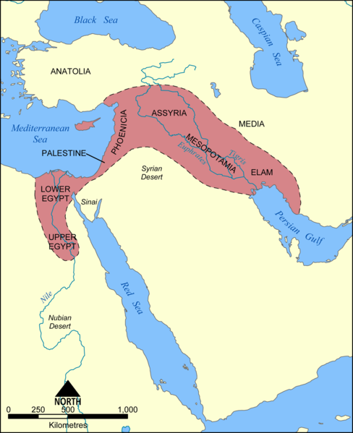
GEOGRAPHY OF MESOPOTAMIA
WHAT WERE THE TWO MOST IMPORTANT PHYSICAL FEATURES?
Mesopotamia is located in iraq
This is in the middle east
Major Physical Features:
Tigris river
Euphrates River
Fertile crescent
Persian Gulf
Mesopotamia civilization is PART OF A REGION CALLED THE the fertile crescent
THE CIVILIZATION was built along the tigris and euphrates River.
The Two Rivers were key to life and success!

Slide 5
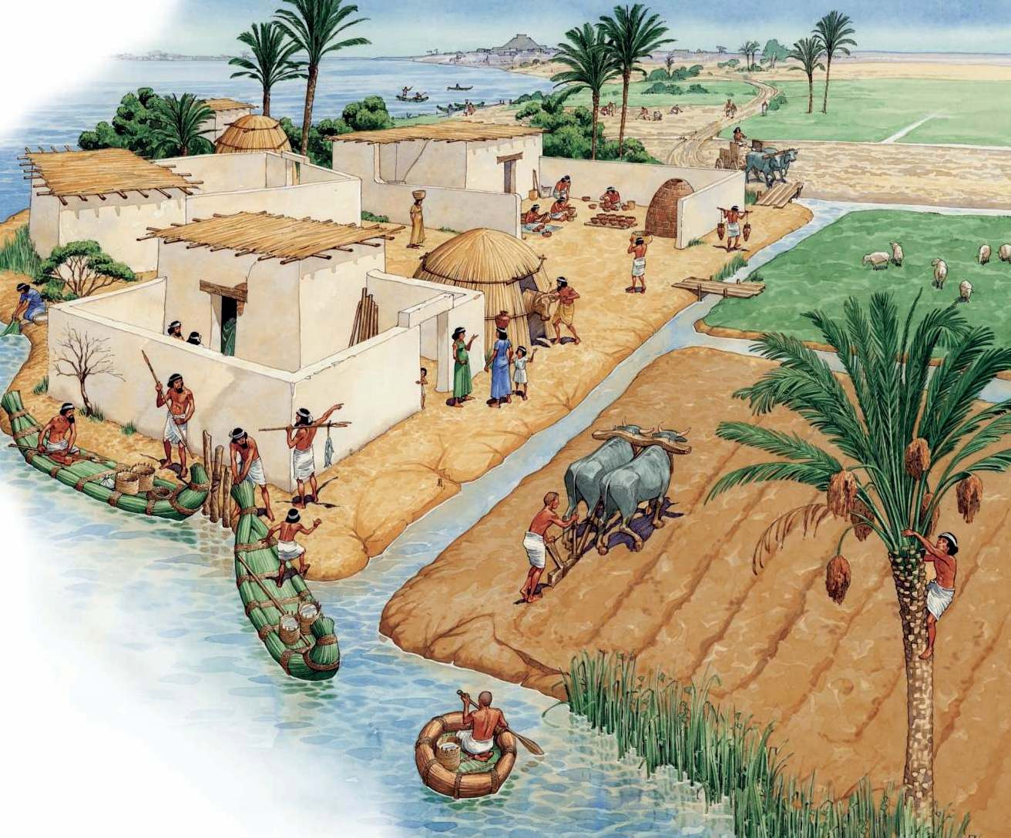
THE BEGINNING OF AGRICULTURE
WHAT DID SETTLERS HAVE TO DO IN ORDER TO FARM IN THE REGION?
The rivers flowed from the mountains down to the Persian Gulf.
Early settlers farmed the land and used resources from the land to improve life.
timber (wood) → boats
metals & stone→ tools
Cities developed along the rivers
Early settlers had to irrigate the land along the banks of the rivers in order for their crops to grow.
REMEMBER: IRRIGATE MEANS TO CONTROL THE WATER OF THE RIVERS

Slide 6
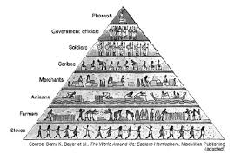
CREATING ORDER
What are the two
systems
that created order in mesopotamia?
DUE TO POPULATION RISING IN MESOPOTAMIA IT WAS IMPORTANT TO CREATE ORDER.
THE FIRST SYSTEM USED TO CREATE ORDER WAS DIVISION OF LABOR
Every person in the civilization had a different job to create a successful and well rounded civilization
THE SECOND SYSTEM USED TO CREATE ORDER WAS SOCIAL HIERARCHY
Every person was then ranked into a rank
The rank of a family is determined by the job you had in the civilization.
Jobs that were hard labor were always at the bottom of the social pyramid
INDEPENDENT EMPIRES MADE THE LARGE AREA OF MESOPOTAMIA EASIER TO CONTROL
Each empire had their own laws, army, gov’t, and leaders
Often times empires were competitive with each other for control over land inside a civilization

Slide 7
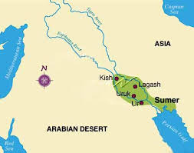
THE FIRST EMPIRE
WHAT
3 INVENTIONS IS
SUMER KNOWN FOR?
tHE PEOPLE WHO LIVED IN SUMER WERE CALLED Sumerians
Existed FROM 3000-1800 BCE
BCE=BEFORE COMMON ERA
(THINK NEGATIVE NUMBERS)
tHE EMPIRE OF SUMER HAD MANY CITIES
THEY SHARED THE SAME CULTURE AND TRADED WITH ONE ANOTHER.
INVENTIONS SUMER IS KNOWN for:
AGRICULTURAL SOCIETY→ CREATED A SURPLUS OF FOOD
WHEEL→ PLOW (FARMING) AND CART (TRADING)
CUNEIFORM→ FIRST WRITING SYSTEM

Slide 8
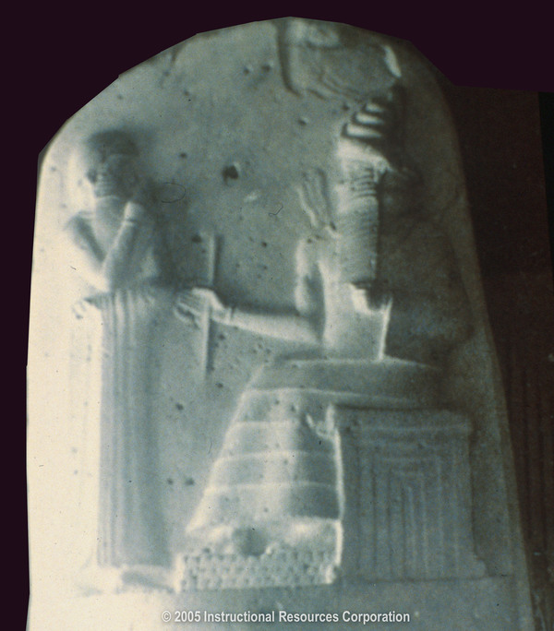
THE SECOND EMPIRE
WHAT
2 INVENTIONS IS
BABYLONIA KNOWN FOR?
tHE PEOPLE WHO LIVED IN BABYLON WERE CALLED BABYLONIANS
Existed FROM 1800-1200 BCE
BCE=BEFORE COMMON ERA
(THINK NEGATIVE NUMBERS)
INVENTIONS BABYLONIA IS KNOWN for:
CALENDAR→ USED TO KNOW WHEN RIVERS WOULD FLOOD
LAW→ KING HAMMURABI: CLEAR RULES, CLEAR PUNISHMENTS
THOUGHT THAT THE LAWS WERE GIVEN TO HAMMURABI BY THE GODS→ THIS KEPT PEOPLE FROM REBELLING

Slide 9
THE THIRD EMPIRE
WHAT
2 INVENTIONS IS ASSYRIA KNOWN FOR?
tHE PEOPLE WHO LIVED IN ASSYRIA WERE CALLED ASSYRIANS
Existed FROM 1200-539 BCE
BCE=BEFORE COMMON ERA
(THINK NEGATIVE NUMBERS)
tHE EMPIRE OF ASSYRIA WERE FIERCE WARRIORS WITH MANY WAR STRATEGIES
THEY CONQUERED BABYLONIA AND TOOK CONTROL OF A LARGE PART OF MESOPOTAMIA.
INVENTIONS ASSYRIA IS KNOWN for:
TRADE→ USED BOATS TO TRADE GOODS
WAR→ TRAINED TO TAKE OVER OTHER AREAS EVEN IF THEY HAD WALLS TO PROTECT THEM.

Slide 10
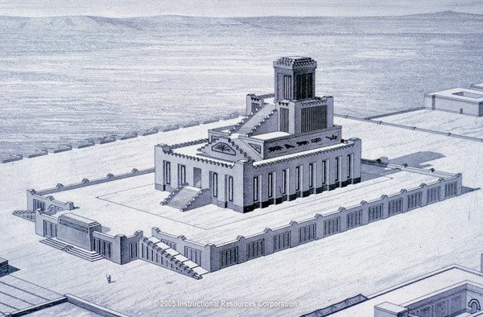
RELIGION IN MESOPOTAMIA
HOW WERE THE
GODS/
GODDESSES IMPORTANT?
THE PEOPLE WHO LIVED IN MESOPOTAMIA WERE POLYTHEISTIC
EACH EMPIRE HAD A ZIGGURAT IN THE CENTER OF THEIR LAND.
USED FOR MANY REASONS:
RELIGIOUS CEREMONIES
SCHOOL TO TEACH CUNEIFORM WRITING
OFFICIAL MEETINGS WITH THE KINGS
EACH EMPIRE WAS CONNECTED BY THEIR RELIGION:
IT IS THOUGHT A GOD/GODDESS WAS ASSIGNED AN EMPIRE TO PROTECT
THE GODS/GODDESSES WERE IMPORTANT BECAUSE THEY DEALT WITH NATURE & DAILY LIFE

Slide 11
Map Reading: Mesopotamia
What two rivers run through the Fertile Crescent?
What body of water do the rivers flow into?
What sea is located to the west of the rivers?
What is the area called that is shown by the color pink?

