Slide 1
Introduction to the World Religions
Unit 9
January 5

Slide 2
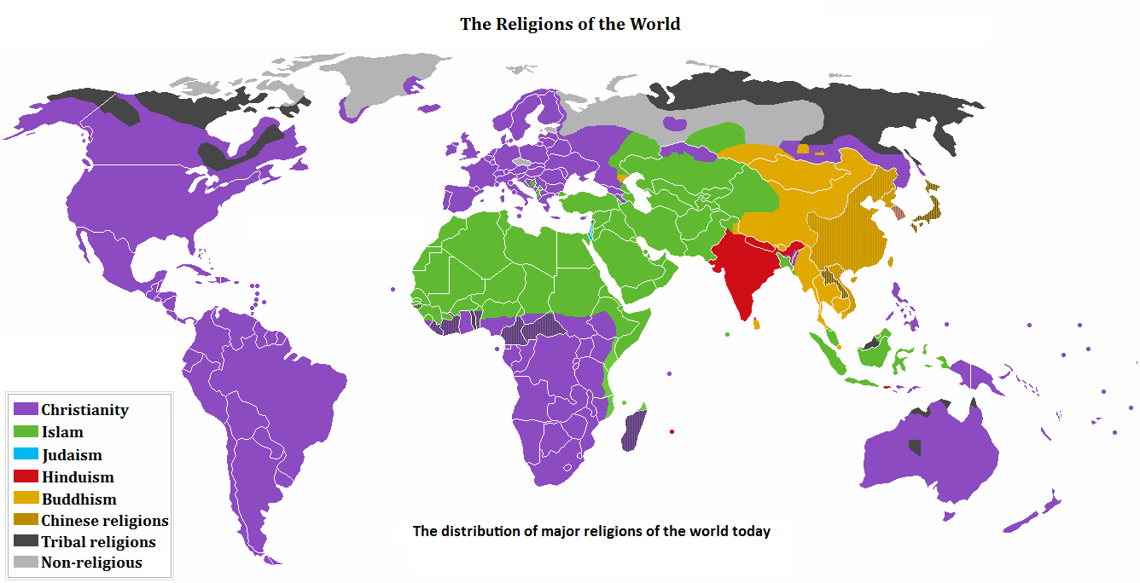
Regions of the world
Using the map key, what do you notice about the colors on the map? What areas have more of the same color? What does that tell you about that area?

Slide 3
Followers of Religions
Religion | Followers | Founder
Judaism | 14.5 million | Abraham
Christianity | 2 billion | Jesus Christ
Islam | 1.1 billion | Muhammad
Buddhism | 362 million | The Buddha
Hinduism | 820 million | No one is founder

Slide 4
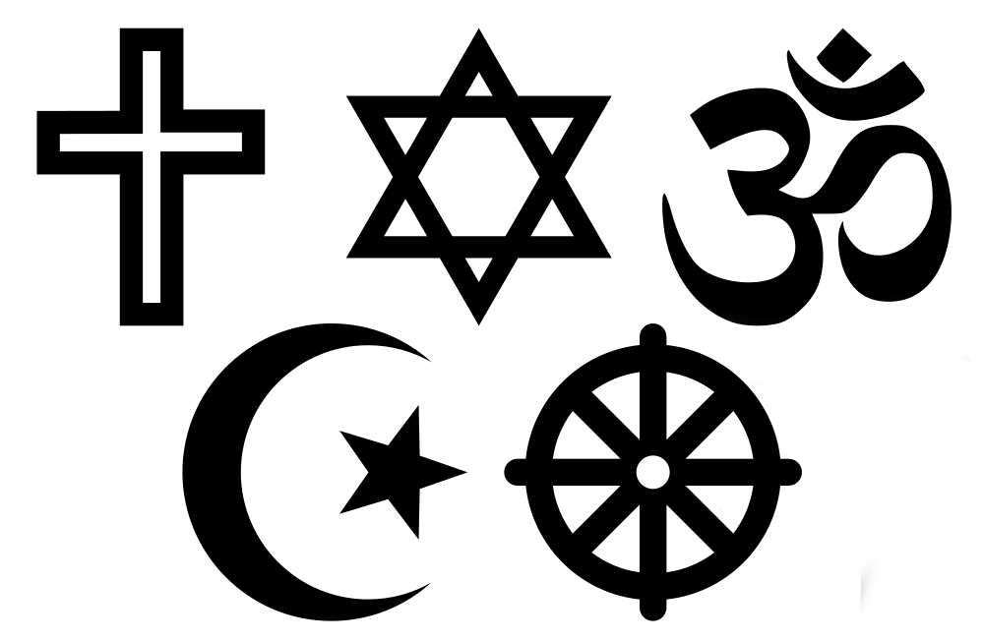
What is a Religion?
A religion is an organized system of beliefs, ceremonies, and rules used to worship a god or a group of gods.

Slide 5
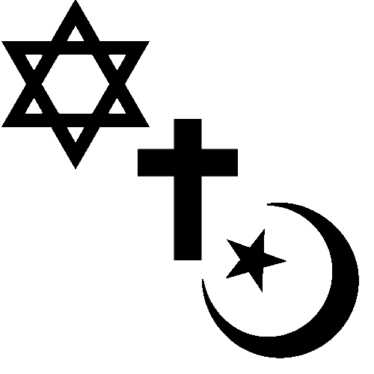
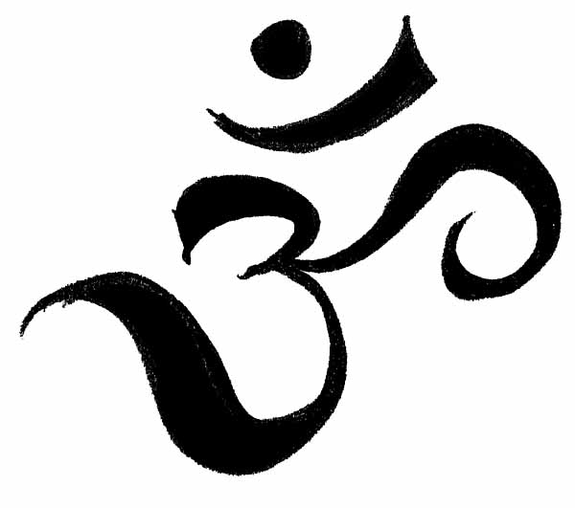
Types of Religions
1. Monotheistic religions believe in one god.
2. Polytheistic religions believe in many gods.

Slide 6
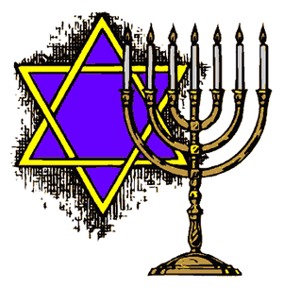
wHICH CAME FIRST?
ORDER OF MONOTHEISTIC RELIGIONS
1st World Religion→ Judaism
tIME PERIOD 2000 BCE
2nd World Religion → Christianity
tIME PERIOD 26-36 BCE
3rd World Religion → Islam
tIME PERIOD 610 CE

Slide 7
Monotheistic Religions

Slide 8
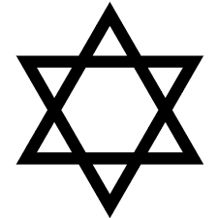
Judaism→ MONOTHEISTIC
Name of deity is Yahweh (God in hebrew)
Abraham is the founder of Judaism.
Followers of Judaism are called Jews
Follow the rules of the ten commandments.
The Star of David is the symbol for Judaism.
Their holy book the Torah.
Is a long scroll hand-written in Hebrew → (traditional Jewish language).
Leaders are called Rabbis

Slide 9
Christianity→ MONOTHEISTIC
Name of deity is God
Christianity was influenced by Judaism.
Founder is Jesus→ the son of God
Follow the rules of the ten commandments.
Their holy book the Holy Bible.
Followers are called Christians
The Christian symbol is the cross.
Leaders are called priests, ministers, monks, and nuns

Slide 10
Islam→ MONOTHEISTIC
Name of deity is Allah (God in Islam)
Muhammad founded the religion
Their holy book the Qur’an.
The Islamic symbol is the crescent moon and star.
Followers are called Muslims
Leaders are called Ulama and Imam→ lead prayers
Follow the 5 pillars of faith to guide their life.

Slide 11
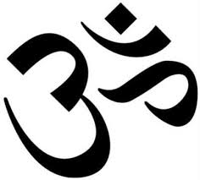
Polytheistic Religions

Slide 12
Hinduism→ POLYTHEISTIC
Hinduism is the world’s oldest religion.
There is no founder
They do not have just one holy book→ Vedas is one example
The symbol is the “AUM (OM)” symbol.
Leaders are called guru, holy man, Brahmin priest
Hindus believe in karma and reincarnation
They use meditation to reach a peaceful state called nirvana

Slide 13
Buddhism→ POLYTHEISTIC
The Buddha is the founder Buddhism.
He was known as Siddhartha Gautama a prince before becoming Buddha
Followers of buddhism are called Buddhist
Follow the rules of the eightfold path to reach nirvana.
The Wheel is the symbol.
They do not have one holy book→ Dhammapada is one example
Leaders are called monks and nuns

