Slide 1
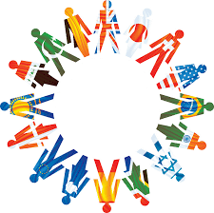
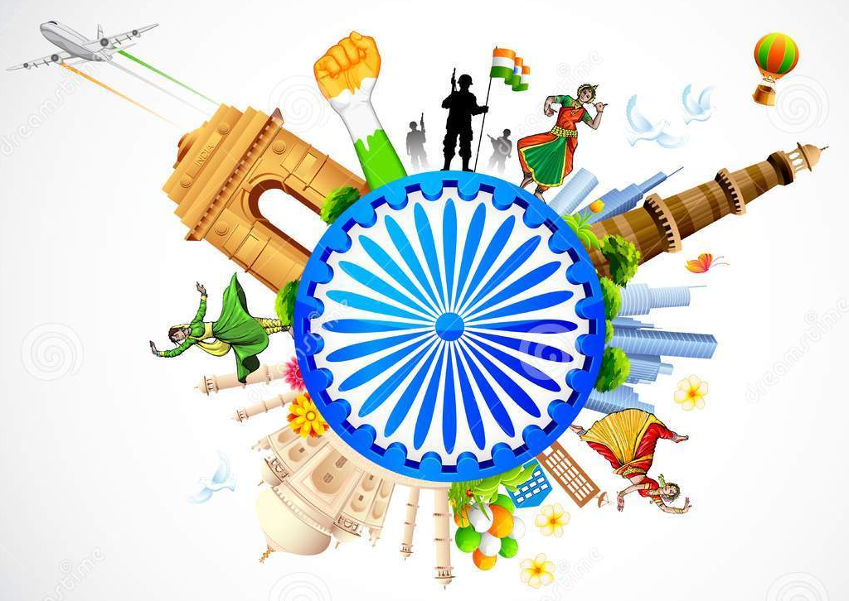
ELEMENTS OF

Slide 2
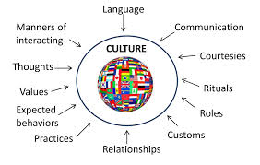
CULTURE IS...
How is your culture given to you?
The shared behaviors of a group.
determines how we view the world around us.
Culture is passed down from one generation to the next.

Slide 3
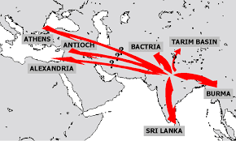
THE BEGINNING
CULTURAL HEARTH: is where culture begins
Think of this as the start line of the idea!
WHO STARTED THE TREND?
Historical Examples:
Hinduism religion started in india
The invention of the wheel started in Mesopotamia → changed farming!
Bonus: Where did the idea of building a road to travel on come from?
WHat is it called where CULTURE BEGINs?

Slide 4
THE SPREAD OF CULTURE
CULTURAL DIFFUSION is the movement of culture from one place to another.
This happens when people migrate, travel, and trade goods/ideas.
Are there other ways cultures can spread?
Historical Example:
Christianity spread from Europe to North America when missionaries traveled to spread their religion to others.
How does culture move?

Slide 5
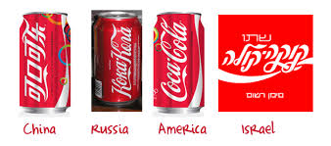
Impact of Cultural Diffusion
What has cultural diffusion improved?
Cultural diffusion has taken place since the beginning of civilizations.
When different cultures come in contact with each other they spread their culture and learn from each other.
THE RESULT→
Religions have moved around the world.
countries shared goods with each other that they normally wouldn’t have
Civilizations built upon each other's ideas and improve them→ language, laws, farming
BONUS→ How does this relate to technology?

Slide 6
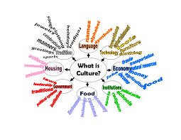
SIX ELEMENTS OF CULTURE
What do the six elements of culture do?
Each element of culture explains a small part of that culture. When you put them all together you understand the whole picture.
Social Organization
Traditions and Values
Language
Religion
Art and Literature
Forms of government

Slide 7
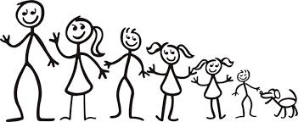
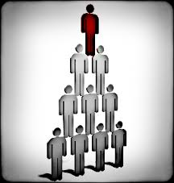
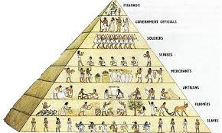
SOCIAL ORGANIZATION
What are the 2 types of social organization?
Social Organization looks like pyramid.
It is a structure that groups people to create order, determine jobs, and a chain of command.
FAMILY STRUCTURE:
Respect your elders
Through the family children learn how they are expected to act and what to believe.
POLITICAL STRUCTURE:
Grouped based on birth
Your parents status is your status
Higher rank depends on what is important to that culture:
Religion, Money, Leadership
lower class vs. upper class

Slide 8
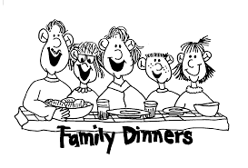
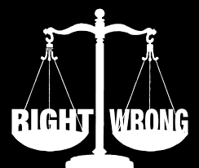
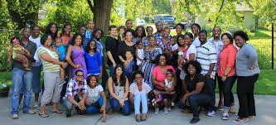
TRADITIONS & VALUES
How do you learn about your traditions & values?
Traditions and Values are learned behaviors taught to you by your immediate or extended family or society.
Traditions: a celebration or custom passed down that has meaning to your family from the past.
Examples:
Family dinners
Bedtime stories
Family Reunions
Trick or Treating
Movie Night
Birthdays
Moral Values:
Ideas of right and wrong that are taught through family and society.

Slide 9
LANGUAGE
Language is how people communicate
written, spoken, signed
Some cultures may speak the same language, but sayings and words can mean different things
United Kingdom [English]: biscuit = cookie
Phrases and body language are determined by your culture
EYE CONTACT
American Culture = polite and respectful
Asian Culture = rude and challenging authority
Why is language important?

Slide 10
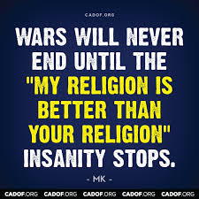
RELIGION
Name two ways religion can impact culture.
Religion impacts your culture by:
What ceremonies/holidays you practice
What you view as right and wrong
The food you eat or can not eat
The clothing you wear
SPREAD OF RELIGION:
This can cause conflict between cultures.

Slide 11
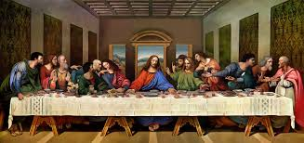
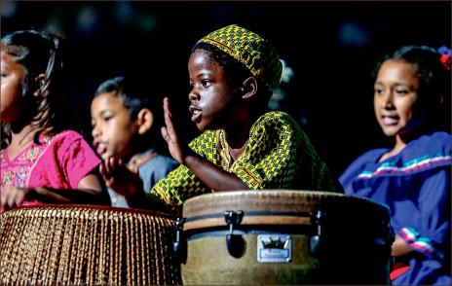
ART & LITERATURE
HOW DO WE HAVE KNOWLEDGE ABOUT PAST CULTURES?
ART = paintings, pottery, sculptures, music
LITERATURE= books, plays, poems, holy books, laws
Art and literature are ways culture has been recorded and passed down through generations.
Cultures have different art & literature that hold meaning to them.

Slide 12
GOVERNMENT
How does government impact culture?
Throughout history and still today the style of government has impacted the culture in the area.
Creates Laws
Personal Freedom vs. Control
Provides Safety
Protection vs War
Improves Quality of Life
Jobs, Inventions, Resources

Slide 13
Whole Class: Cultural Differences
As you are watching the video….
Tally each time one of the Lost Boys from Sudan, does not know about or struggles with American ‘norms’.
List what the American ‘norms’ are that the Lost Boys struggle with.
Write down how Americans react to the Lost Boys in the video.

