Slide 1
MAP SKILLS
UNIT 2: Map skills

Slide 2
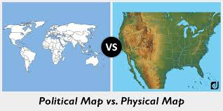
Types of Maps
What are the two types of maps?
Physical Map
Show landforms
Mountains, deserts, rivers
Uses natural colors on the map
Physical Map
Show border lines
Countries, states, cities, capitals
Use brighter colors on map

Slide 3
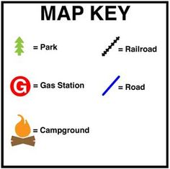
Tools of a map
Why are the tools of a Map important?
The tools of a map help you to understand what the map is showing you.
Title of the map
Map Key and Symbols
Title Rose

Slide 4
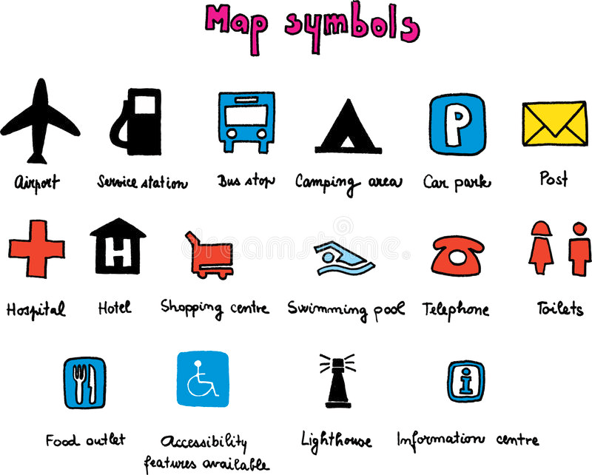
symbol
How do symbols help you read a map?
Symbol
A symbol is a picture
That represents something on a map
Symbols are located on the map
And in the map key
Symbols are a way to explain
What the map is showing

Slide 5
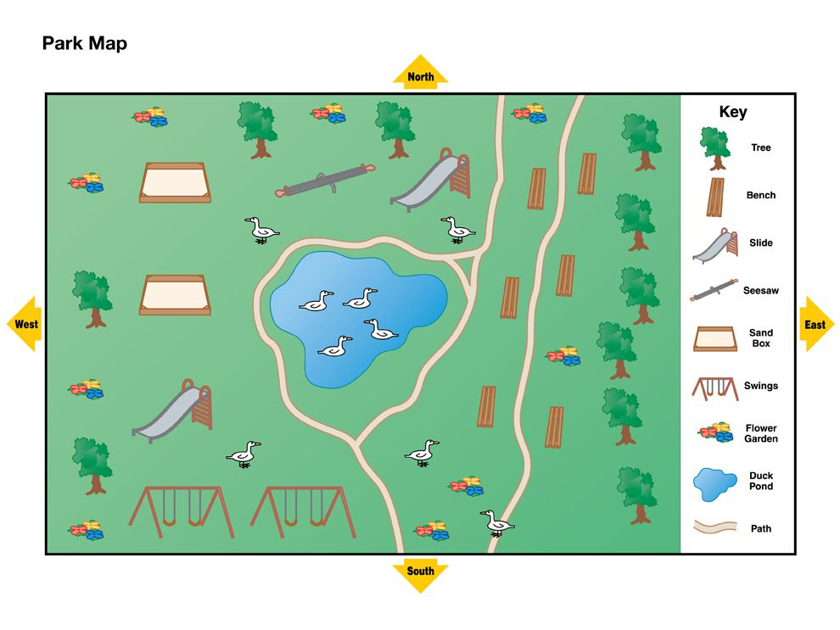
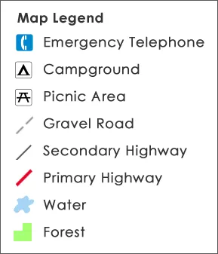
Map key or legend
What is the purpose of the map key?
The key or legend is an area on the map that shows what each symbol represents.
The key can show anything on the map.
The map key makes the map make sense.

Slide 6
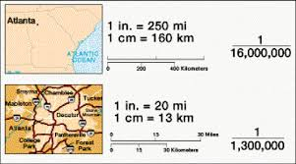
Scale
What is a scale?
A map is not and can not be the actual size of the area.
The scale is a measuring tool.
The distance on the map can be converted to actual distance.
One inch = one mile

Slide 7
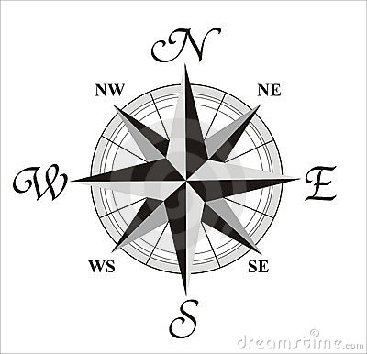
Compass rose
What are the two types of directions on a compass?
The compass show the direction of locations on the map.
Cardinal directions:
North
South
East
West
Intermediate directions:
NorthEAST
Southeast
NorthWest
SouthWest

Slide 8
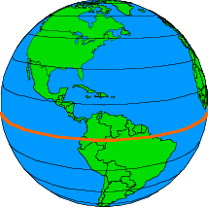
Latitude or parallels
What two directions do latitude lines measure?
There are imaginary lines on a map for measuring distance in DEGREES.
They wrap around the world HORIZONTALLY
EAST TO WEST
They measure NORTH to SOUTH on the globe
Think if you were climbing the lines of a ladder you move up and Down.
The main line of latitude is the EQUATOR

Slide 9
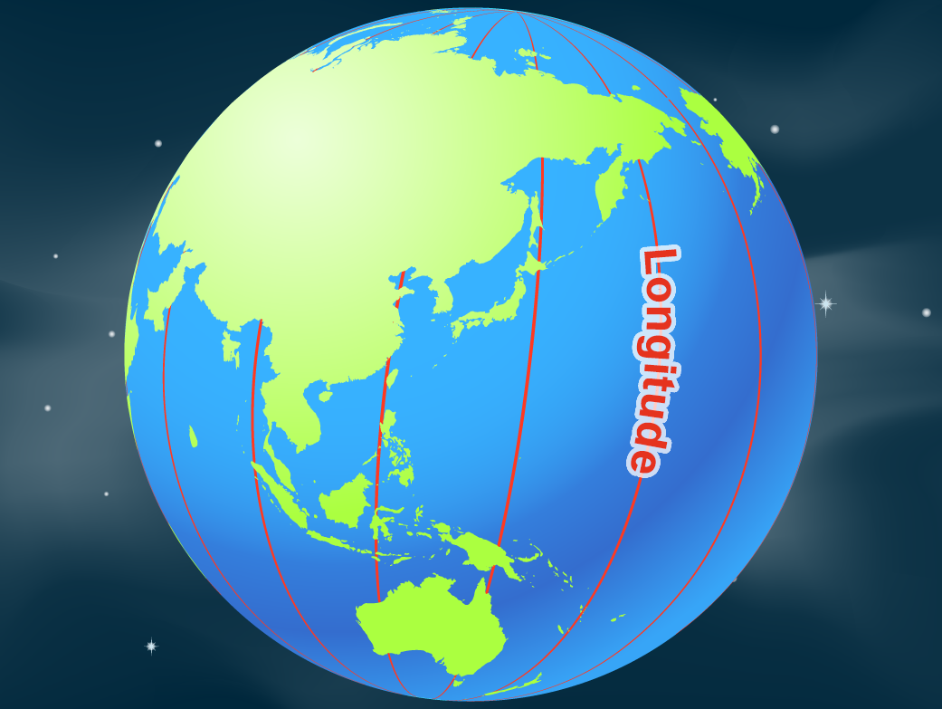
Longitude or meridians
What two directions do longitude lines measure?
There are imaginary lines on a map for measuring distance in degrees.
They wrap around the world VERTICALLY
NORTH TO SOUTH
They measure EAST to WEST on the globe
Think if you ARE JUMPING the lines YOU MOVE SIDE TO SIDE
The main line of longitude is the PRIME Meridian.

Slide 10
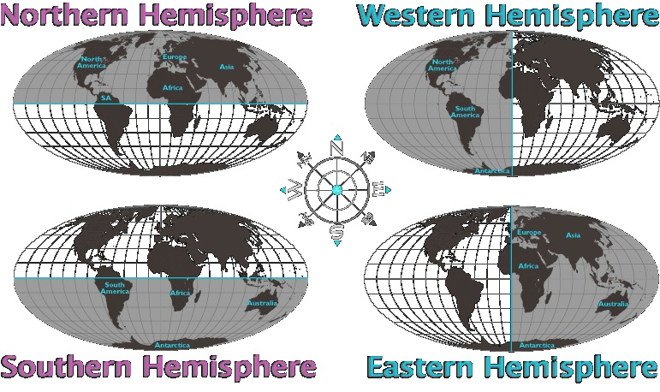
Major lines
How many hemispheres are created by the Equator and Prime Meridian?
Equator
Measures at 0º degress latitude.
The line divided the Earth hemispheres.
Northern Hemisphere
Southern Hemisphere
Prime Meridian
Measures at 0º degress longitude.
The line divided the Earth hemispheres.
Eastern Hemisphere
Western Hemisphere

