Slide 1
Population
UNIT 4: HUMAN GEOGRAPHY
World Population Now

Slide 2
Why do you think the population has recently started to grow so quickly?
What are some reasons people are living longer?
What makes an area good for people to live and survive there?
Seven Billion: How Did We Get So Big?

Slide 3
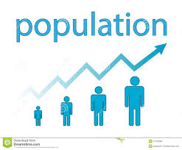
Let’s define POPULATION
Why is the population always changing?
Population is the total number of people who live in a specific place.
The population of the world is constantly changing because people are constantly being born & dying.
Births= Birth rate
Deaths= Death Rate
Geographers study 3 things when analyzing population:
Which places have high and low population?
Why some places have higher or lower population?
What causes population rates to change?

Slide 4
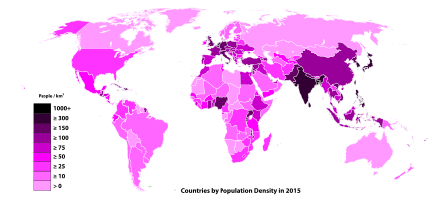
Calculating Population Density
How does the population impact the population density?
Population density shows the average of how many people live per sq. mile in an area.
Population density will be higher when the population in the area is higher.
Think about the different communities people live in:
Urban: High Population = High Population Density
Suburban: Medium Population = Medium Population density
Rural: Low Population = Low Population Density
To find the population density of a location:
ADD up the total number of people living in an area
DIVIDE by the total amount of land they occupy.

Slide 5
Understanding Population Density
What color represents the lowest population density?
What color represents the highest population density?
Which continent has the country with the highest population density?
Why do you think areas that are light pink have such few amount of people living there?

Slide 6
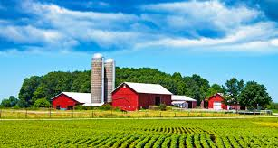
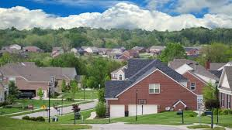
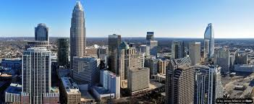
Types of communities
How does the amount of land change in each type of community?
RURAL
Large amount of land
Small amount of people
Farms
SUBURBAN
Medium amount of land
Medium amount of people
Neighborhoods
URBAN
Small amount of land
Large amount of people
Skyscrapers & apartment buildings

Slide 7
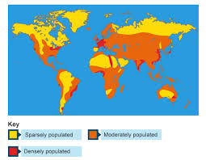
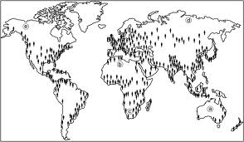
Population Distribution
What does population distribution explain?
Explains how and why people are distributed (spread) around the world.
When answering how and why population distribution is the way it is geographers use three factors to explain it:
ENVIRONMENTAL→ WHAT RESOURCES DOES THE LAND PROVIDE?
ECONOMICAL→ HOW DO PEOPLE MAKE MONEY THERE?
POLITICAL→ WHAT IS THE GOVERNMENT LIKE THERE?

Slide 8
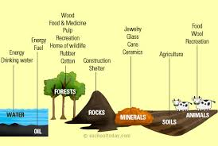
ENVIRONMENTAL FACTORS
How does the environment affect population distribution?
Environmental factors explain what resources are on the land.
Could be positive or negative
What natural resources does the land have?
Oil, coal, cotton, etc.
These resources are important because they can be traded for $ or used
What type of land is in the area?
Fertile land (farming) or access to water
What is the climate like?
Too hot or too cold= lower population

Slide 9
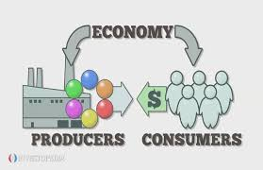
Economic FACTORS
What does economic refer to?
Economic factors explain how resources & goods are used to make money for the area!
Economic Factor Cycle:
A strong economy means more money is in the area.
If more money is in the area more businesses will move there.
More businesses means more jobs
More jobs means more people want to live there

Slide 10
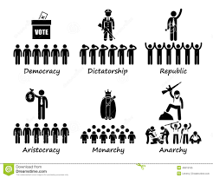
political FACTORS
What do political factors explain?
Political factors explain how the government impacts the quality of life of the people in the area.
Political factors that impact people’s lives:
Does the government…
protect the people from outside invaders?
protect the people from crime inside the country
have fair laws, civil rights, & freedoms

Slide 11
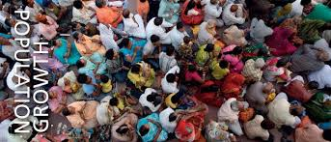
Impact of Population Growth
What is ONE impact of population growth?
The world’s population has been increasing rapidly over the last century (100 years).
CHALLENGES DUE TO RAPID INCREASE: As the population increases it becomes difficult to provide the basic needs
food, clean water, shelter
OVERCROWDING: Many people move to the cities to make a better life for themselves, but then people are fighting each other for resources they need to survive.

