Slide 1
Unit 2 Map Skills
VISUAL VOCABULARY

Slide 2
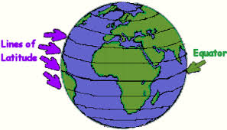
LATITUDE
Imaginary lines drawn on maps from east to west to locate places north or south of the equator

Slide 3
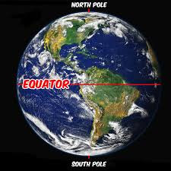
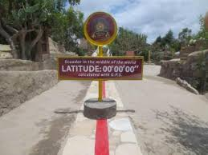
Equator
An imaginary line that runs horizontally through the center of the Earth, dividing the Northern and Southern hemispheres.

Slide 4
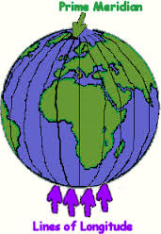
longitude
Imaginary lines drawn on maps from north to
south to locate places east or west of the equator.

Slide 5
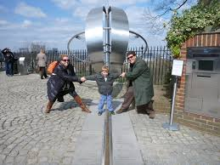
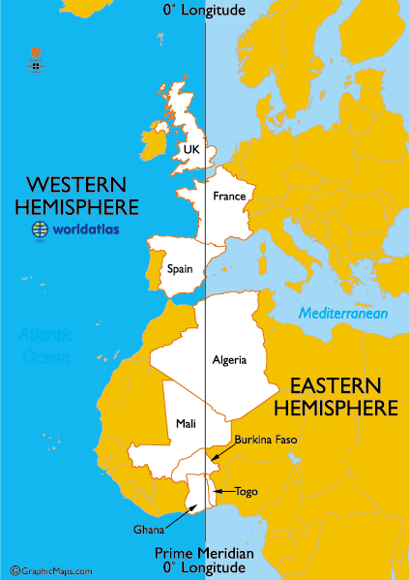
Prime Meridian
An imaginary line that runs through the center of the Earth vertically dividing the Eastern and Western hemispheres.

Slide 6
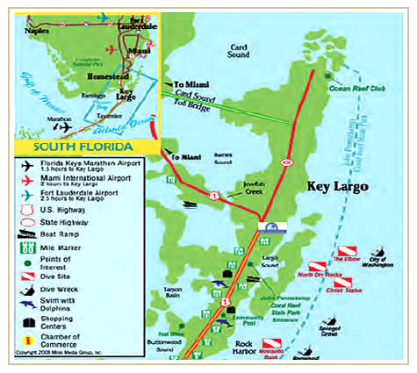
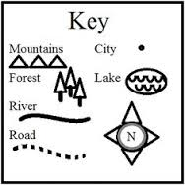
Map Key
A small chart included on a map that gives descriptions of what symbols are used and what they stand for.

Slide 7
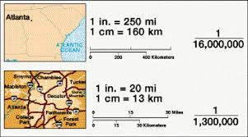
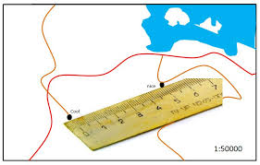
Scale
Represents the distance between two locations on the map. Ex: 1 inch on the map equals 1 mile on the ground.

Slide 8
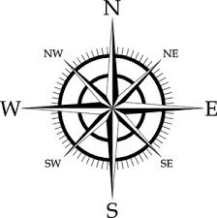
Compass Rose
A design on a map that shows directions.

Slide 9
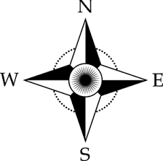
Cardinal Directions
The four major compass points of North, South, East, West used to navigate a map.

Slide 10
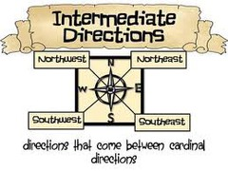
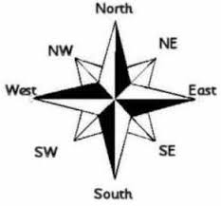
Intermediate Directions
The in-between compass points of Northeast, Northwest, Southeast, Southwest.

Slide 11
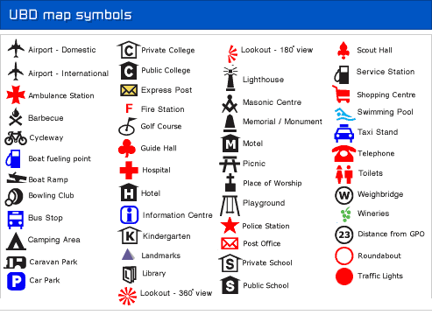
Symbol
A picture that is used to represent an object on a map.

Slide 12
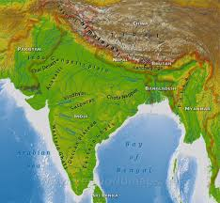
pHYSICAL mAP
This map shows naturally made landmarks. These may include and are not limited to rivers, lakes and mountains.

Slide 13
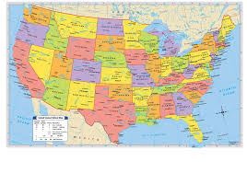
pOLITICAL mAP
This map shows boundaries defining nations, countries, states, provinces and territories and the major cities that lie within them.

